Slide 1

WELCOME
We’ll get started momentarily

Slide 2
AI FOR LEADERS
GE HealthCare + GA

Slide 3

Welcome from GE HealthCare

Slide 4





GENERAL ASSEMBLY
CONTENT AREAS
General Assembly is at the forefront of tech talent development specializing in today’s most in-demand skills. The leading source for upskilling, reskilling, and revolutionizing teams, GA programs offer proven impact on the job, both for the employee and the employer.
Engineering & Development
Data & AI
Product & UX
Digital Marketing
FLAGSHIP CAMPUSES
FAST FACTS
80,000+ alumni, 19,000+ hiring partners
25,000+ employees of Fortune 500 companies trained in 20+ countries
Flagship campuses in NY and Singapore + global virtual learning
General Assembly is a brand of the Adecco Group, the world’s foremost provider of staffing, career transition, and talent development solutions.

Slide 5
Meet Your Instructor
tktk
Tktk

Slide 6

The AI Landscape
Ethical and Legal Considerations in AI
Fundamentals of Effective Prompt Writing
Strategic Considerations
The Future of AI

Slide 7
AI for Leaders
The AI Landscape

Slide 8
Summarize current trends and applications in AI
Evaluate your organization's place in the AI ecosystem
Identify talent and upskilling needs based on organizational goals

Slide 9
Recap: What is Generative AI?
Generative AI is the most recent advancement in the field of machine learning
Generative AI technologies are capable of creating new content, ranging from text to images and video
The most popular generative AI technologies are called Large Language Models, or LLMs for short
Put simply, LLMs are models that specialize in predicting the next word in a sentence.
Notes:
PURPOSE:
Provide a concise overview of Generative AI and its relationship with Large Language Models (LLMs).
TALKING POINTS:
• Generative AI represents the cutting edge in machine learning, expanding the boundaries of what machines can create.
• This technology has the ability to generate a wide array of new content, including text, images, and videos, simulating human-like creativity.
• LLMs are a subset of generative AI that focus on text generation, predicting subsequent words based on context, thus simulating understanding and composition of language.
TEACHING TIPS:
• Draw parallels between human creativity and AI content generation to help learners relate to the technology.
• Use examples of LLMs in action, like writing assistance, to demonstrate their capabilities.
• Emphasize the "predictive" nature of LLMs, using the analogy of predictive text on smartphones to make it more tangible.

Slide 10
5 Minutes
You’ve Heard A Lot About GenAI Already, But…
What have you experienced with GenAI?
What concerns do you have with AI?
What burning questions do you have?
Notes:
PURPOSE:
Engage the audience in a reflective conversation on their experiences, concerns, and curiosities regarding Generative AI.
TALKING POINTS:
• Encourage sharing of personal experiences with Generative AI to understand the variety of interactions within the group.
• Open the floor to any concerns participants may have about AI, such as ethics, bias, or job displacement, to acknowledge and address potential apprehensions.
• Invite "burning questions" the audience has, which can reveal their depth of interest and areas of curiosity about Generative AI.
TEACHING TIPS:
• Create an inclusive environment where all experiences and viewpoints are valued, encouraging quieter participants to share.
• Be prepared to provide informative responses to concerns, bringing in current research and expert opinions.
• Use the questions as a springboard for deeper discussion, noting recurring themes for follow-up in later sessions.

Slide 11
LET’S ASK COPILOT WHAT IT THINKS.
Notes:
Purpose - An ice breaker and a chance to show ChatGPT early.

Slide 12
What Leaders Need To Know
What are the legal & compliance needs?
Do we wait, or act now?
Incremental or Transformational change?
What is the long-term market outlook?
How much change management is required?
What infrastructure is required?
Notes:
Note: Andrej Karpathy was one of the original members of OpenAI, and rejoined the team in February 2023.
Transition: The breakthrough has come through the fact that we are now able to train models on such a huge scale, and this is where “Large” comes in.
PURPOSE:
Guide executives in understanding the key considerations for integrating AI within their business strategies.
TALKING POINTS:
• Highlight the importance of understanding the evolving legal and compliance landscape around AI to mitigate risks.
• Stress the urgency of deciding whether to be an early adopter of AI technology or to take a wait-and-see approach.
• Discuss the potential impact of AI on the market and how it might alter the competitive landscape in the long term.
• Evaluate the degree of change management needed to successfully implement AI technologies within the organization.
• Consider whether AI will lead to incremental improvements or necessitate a transformational change in business operations.
• Identify the infrastructure requirements for adopting AI, considering both technical and human resource investments.
TEACHING TIPS:
• Use real-world case studies to illustrate the consequences of legal and compliance decisions related to AI.
• Facilitate a pros and cons discussion on early adoption versus a delayed approach to implementing AI.
• Encourage forward-thinking on market trends to anticipate how AI could offer a competitive advantage.
• Emphasize the importance of a well-structured change management plan tailored to the organization's readiness for AI.
• Prompt a strategic dialogue on how AI can either incrementally improve processes or redefine business models.
• Discuss the importance of robust infrastructure to support AI initiatives, including technical systems and skilled personnel.

Slide 13
AI is quite possibly the most important – and best – thing our civilization has ever created, certainly on par with electricity and microchips, and probably beyond those.
Marc Andreessen, Co-founder Andreessen Horowitz
Notes:
PURPOSE: This slide aims to underscore the transformative potential of AI, aligning it with other game-changing technologies like electricity and microchips to deepen our understanding of its potential business applications and impact.
TALKING POINTS:
Marc Andreessen is no stranger to technological revolutions, having been involved in shaping the internet.
He equates the potential of AI to groundbreaking advancements like electricity, suggesting AI could power a fourth industrial revolution.
However, it's important to approach the hype with a balanced view, given that not all hyped-up technologies live up to their promises.
TEACHING TIPS
Marc Andreeson created the first widely used web browser, Mosaic, and so has seen multiple hype cycles before. And yet he is arguing the that AI will power a fourth industrial revolution after those of steam, electricity, and information technology.
While we should remain sceptical about any hyped up technology - remember NFTs? - we think it may not be quite so fanciful to imagine that the impact on the world of work could ultimately be as huge as the internet, ecommerce, or even the humble spreadsheet.

Slide 14
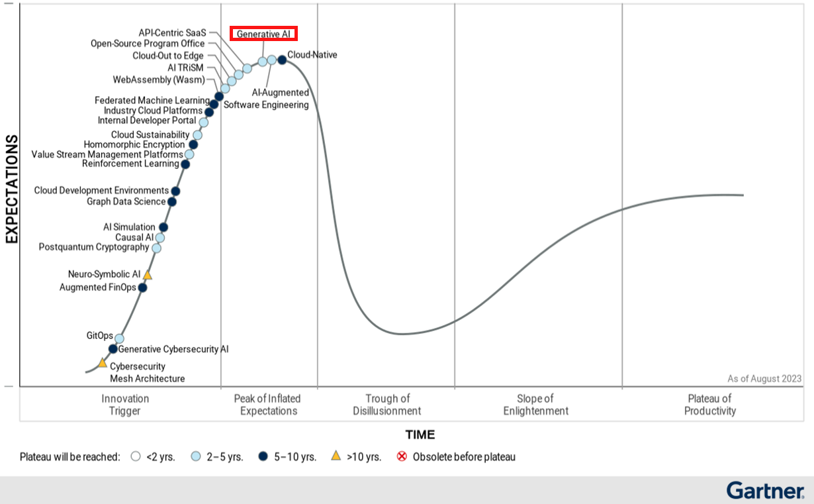
We are at peak hype, so should we still explore genAI?
Notes:
PURPOSE:
To critically evaluate the decision to invest in Generative AI amidst the current heightened excitement around the technology.
TALKING POINTS:
• Identify the phenomena of the hype cycle and where Generative AI currently stands, emphasizing the pattern of inflated expectations.
• Examine the potential risks and rewards of investing in a technology at its hype peak, including the possibility of a subsequent disillusionment phase.
• Discuss strategic approaches to investment in Generative AI that can weather the hype cycle's volatility and lead to long-term gains.
TEACHING TIPS:
• Use historical examples of technologies that have gone through the hype cycle to give context to the current status of Generative AI.
• Encourage critical thinking by discussing the implications of acting on hype versus evidence-based decision-making.
• Prompt participants to consider not just the current state of the technology but also its trajectory and potential to reach the plateau of productivity.

Slide 15
YES.
“CEOs should consider exploration of generative AI a must, not a maybe.”
-McKinsey
Notes:
Update speaker notes
Note: We will breakdown each word in “LLM” one-by-one in this lesson. So the first thing to say is that large language models are models but what do we actually mean by models?

Slide 16



The AI Landscape
Foundation Models
Emerging AI Ecosystem
Infrastructure
& Talent

Slide 17
FOUNDATION MODELS
Foundation Models
Emerging AI Ecosystem
Infrastructure
& Talent
When we talk about LLMs or AI Art, we’re talking foundation models.
Deep learning models trained on vast quantities of unstructured, unlabeled data.
Notes:
PURPOSE:
Clarify the concept of Foundation Models and their role in the context of LLMs and AI-generated art.
TALKING POINTS:
• Explain that Foundation Models are a broad category of AI models which underpin various applications including LLMs and AI-generated art.
• Emphasize that these models are trained on large volumes of data that is often unstructured and unlabeled, highlighting the scale of data required.
• Clarify that despite their general-purpose nature, Foundation Models can be fine-tuned for a wide range of specific tasks.
TEACHING TIPS:
• Use analogies to help the audience grasp the scale and scope of the data used in training Foundation Models, such as comparing it to learning from the content of an entire library.
• Discuss the implications of the term "foundation," suggesting that these models provide a base upon which specialized functionalities can be built.
• Consider providing examples of how Foundation Models have been adapted for various domains, stressing their versatility and transformative potential.

Slide 18






PROPRIETARY MODELS:
Foundation Models
Emerging AI Ecosystem
Infrastructure
& Talent
OPEN-SOURCE MODELS:

Slide 19
When to Use Proprietary Models:
Foundation Models
Emerging AI Ecosystem
Infrastructure
& Talent
The top performing model is required
Talent to configure & maintain is low
Low-code options (plugins)
Lacking the proper infrastructure to run a model
Notes:
PURPOSE:
Educate on the scenarios where opting for proprietary AI models is beneficial for an organization.
TALKING POINTS:
• Underline the necessity of choosing proprietary models when the application demands the highest level of performance.
• Highlight the advantage of proprietary models when in-house expertise in AI is limited, as these often come with support and simpler integration tools.
• Point out that proprietary models often offer low-code or no-code solutions which can be advantageous for quick deployment and ease of use.
• Discuss the infrastructure requirements of AI models and how proprietary solutions can be more feasible for organizations without the necessary infrastructure.
TEACHING TIPS:
• Provide examples of proprietary models by leading tech companies like OpenAI, Microsoft, and Google to illustrate the discussion.
• Stress the importance of evaluating the trade-offs between proprietary and open-source models, including cost, flexibility, and proprietary lock-in risks.
• Encourage thinking about the long-term strategic fit of proprietary models within the organization's tech ecosystem.

Slide 20
When to Use Open-Source Models:
Foundation Models
Emerging AI Ecosystem
Infrastructure
& Talent
You need control of your data (running on-prem)
More control of model training and fine-tuning
Potentially lower long-term operating costs
Notes:
PURPOSE:
Explain the advantages of using open-source AI models for certain organizational needs and situations.
TALKING POINTS:
• Emphasize the significance of data sovereignty and how open-source models can be more suitable for companies that require on-premises data storage.
• Discuss the flexibility open-source models offer in terms of customization and fine-tuning to meet specific needs.
• Outline the potential for reduced long-term operating costs associated with open-source models compared to proprietary solutions.
TEACHING TIPS:
• Highlight case studies or examples where businesses benefited from the adaptability of open-source models.
• Encourage a discussion on the importance of having the right skill set within the team to manage and customize these models effectively.
• Point out the commitment required to maintain and update open-source models, ensuring that they remain secure and effective over time.

Slide 21
A New Ecosystem
IMPLICATIONS:
More procurement work
More build vs. buy decisions
More vendor assessments
More infrastructure
Foundation Models
Emerging AI Ecosystem
Infrastructure
& Talent
Services
Software
Model Hubs/
ML Ops
Foundation
Models
Infrastructure
Notes:
PURPOSE:
To explain the layered nature of the new AI ecosystem and its implications for businesses.
TALKING POINTS:
• Outline the multi-tiered structure of the emerging AI ecosystem, from foundational infrastructure to services.
• Explain that as companies engage with this ecosystem, they will encounter increased procurement complexity.
• Discuss the necessity of making strategic decisions between developing in-house solutions or purchasing them, often referred to as build vs. buy decisions.
• Understand that assessing vendors becomes a crucial skill as the number of specialized service providers grows.
• Highlight the need for expanded infrastructure to support advanced AI models and operations.
TEACHING TIPS:
• Use the diagram to visually represent the complexity and interconnectivity of the different layers in the AI ecosystem.
• Prepare to guide discussions on how to navigate procurement in this context, including evaluating cost, scalability, and long-term benefits.
• Encourage participants to consider the implications of each layer for their own business needs, particularly in terms of investment and potential return on investment.

Slide 22
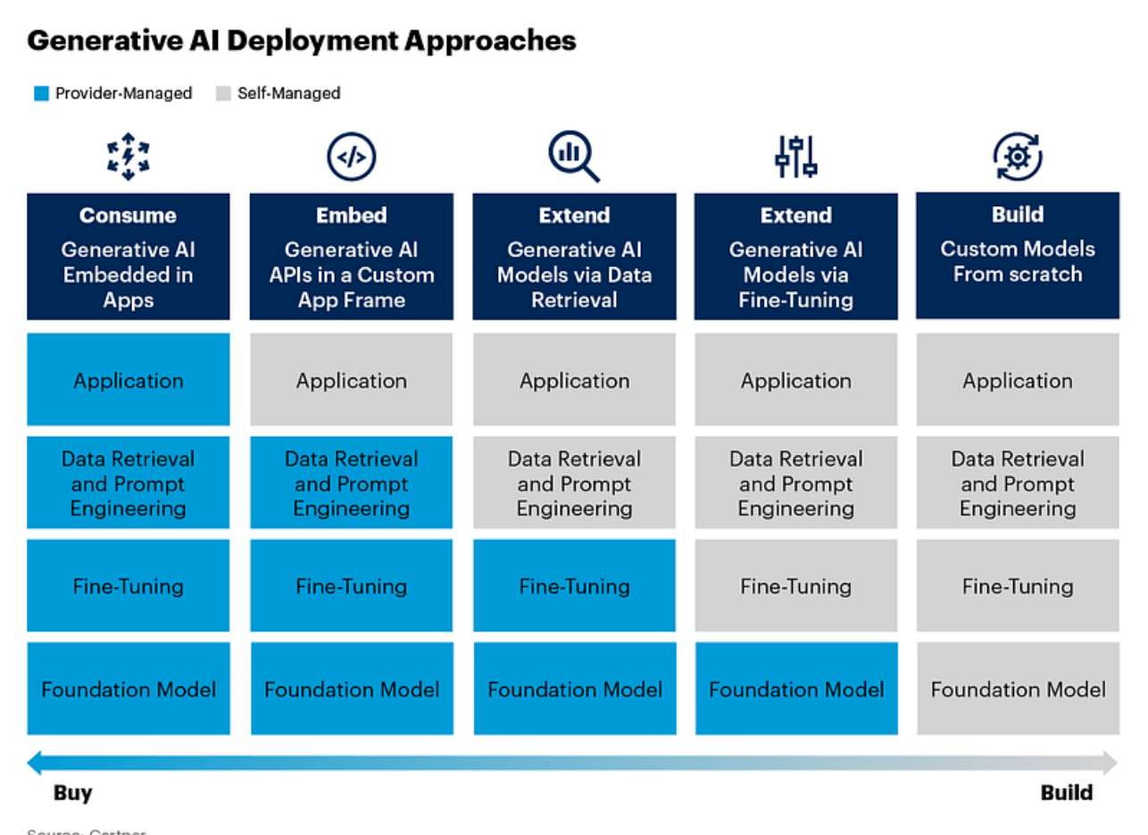
Executives Are Investing in AI Infrastructure
Foundation Models
Emerging AI Ecosystem
Infrastructure
& Talent
Using LLMs can require a little or a lot of infrastructure.
Notes:
PURPOSE:
Describe the range of investment in infrastructure that executives must consider when integrating LLMs into their business processes.
TALKING POINTS:
• Illustrate the spectrum of deployment approaches for generative AI, from provider-managed applications to building custom models from scratch.
• Explain that the infrastructure investment required can vary significantly depending on the chosen deployment approach.
• Emphasize that while using pre-built LLMs may require minimal infrastructure, developing custom models necessitates a more robust setup.
TEACHING TIPS:
• Use this slide to discuss the importance of aligning the deployment approach with the company’s strategic goals and capabilities.
• Encourage participants to consider the balance between the upfront cost of infrastructure and the potential for long-term value creation.
• Highlight the importance of talent and expertise in managing the chosen infrastructure and ensuring the successful deployment of LLMs.

Slide 23
Data: Critical To Customization
Foundation Models
Emerging AI Ecosystem
Infrastructure
& Talent
Training: The process of teaching a machine learning model to recognize patterns in data by adjusting its parameters based on a given dataset.
Fine-Tuning: Adjusting a pre-trained model on a new, often smaller, dataset to specialize it for a specific task.
RAG: Retrieval Augmented Generation combines information retrieval from a large corpus with a generative model to produce more accurate and contextually relevant responses.
Notes:
PURPOSE:
Describe how talent requirements are changing.
TALKING POINTS:
TEACHING TIPS:

Slide 24
Changing Talent Requirements
Foundation Models
Emerging AI Ecosystem
Infrastructure
& Talent
Data Scientist: R&D to create a new model.
MLEngineer: Enables models to run at scale.
“Data Scientist was the sexiest title of the 2010’s.
ML Engineer is the sexiest title of the 2020’s.”
Notes:
PURPOSE:
Describe how talent requirements are changing.
TALKING POINTS:
TEACHING TIPS:

Slide 25
AI for Leaders
Ethical and Legal Considerations in AI
Notes:
This is really interesting part, but since you have your internal resources, we’d touch on it briefly.

Slide 26
Identify major ethical and legal challenges related to generative AI
Evaluate strategies to address or mitigate ethical and legal risks in organizational contexts

Slide 27
Data are generated through a process of abstraction, so any data are the result of human decisions and choices.
The implication is that data are never an objective description of the world.
Notes:
Explanation: Data abstraction is the reduction of a particular body of data to a simplified representation of the whole. Abstraction, in general, is the process of removing characteristics from something to reduce it to a set of essential elements. To this end, data abstraction creates a simplified representation of the underlying data, while hiding its complexities and associated operations.
____
Effective AI comes from data. And the data is an abstraction of the world, not a representation of an actual world. So much of data hasn’t been collected and is missing. Some of the data relies heavily on human decisions that might vary and won’t represent fully the truth. So, here comes the bias.

Slide 28
Statistical vs. Societal Bias
Statistical:
Why? Because our dataset does not accurately represent the world.
Who Can Fix It? The product development team, including data scientists, QA, Design, and Product.
Societal:
Why? Because our dataset represents the world where there is existing bias.
Who Can Fix It? Bias is baked into the data. Development team needs to be aware, but compliance, legal, and ethics experts may be needed.
Notes:
PURPOSE:
To differentiate between statistical and societal biases and identify the responsible parties for addressing these biases in data science.
TALKING POINTS:
• Statistical bias occurs when a dataset does not accurately reflect the real world, which can lead to skewed results in data analysis and model training.
• Societal bias is present when the dataset accurately reflects existing biases in society, implying that the problem lies within societal structures rather than data collection methods.
• The product development team, including data scientists, quality assurance, design, and product professionals, is typically responsible for rectifying statistical bias.
• Societal bias requires a broader approach involving compliance, legal, and ethics experts, highlighting the necessity for interdisciplinary efforts to address deep-rooted biases in data.
TEACHING TIPS:
• Use real-world examples to illustrate the impact of statistical and societal biases on AI and machine learning models.
• Encourage discussion on the responsibility of technologists to recognize and address both types of bias.
• Highlight the importance of diversity within development and ethics teams to ensure a wide range of perspectives when tackling biases.
Constructing a more unbiased dataset
Unfair datasets are the root cause of bias. Therefore, a direct approach to addressing algorithmic bias is reconfiguring unbalanced datasets. Using multiple data points can yield more accurate results while carefully eliminating data points that reflect past biases. However, this approach incurs significant costs.Another method is to correct data imbalances by using more equitable data sources to ensure fair decision-making
Enhancing algorithmic transparency
Engineers write algorithmic models, but they often need help understanding the processes that AI undergoes to produce a specific outcome. Many algorithmic biases are difficult to fully understand because their techniques and methods are not easily visible. This leaves many people unaware of why or how they are discriminated against and lacks public accountability
Technological tools against bias
Data blending process. Blendoor is inclusive recruiting and staffing analytics software that mitigates unconscious bias. It takes candidate profiles from existing online job boards and applicant tracking systems to reduce unconscious bias. Blendoor “blends” candidate profiles by removing names, photos, and dates
Internal ethics governance
External supervision
START
• Statistical bias occurs when a dataset does not accurately reflect the real world, which can lead to skewed results in data analysis and model training.
• Societal bias is present when the dataset accurately reflects existing biases in society, implying that the problem lies within societal structures rather than data collection methods.
One of the most well-documented examples is in facial recognition systems from MIT’s Media Lab.
Facial recognition models from major companies like IBM, Microsoft, and Amazon were found to have much higher error rates for darker-skinned individuals, especially women as 34% vs 0,8%. Why Did This Happen?
Training Data Bias.The datasets used to train facial recognition models were composed of lighter-skinned faces, making the model less effective at recognizing somewhat varying skin color individuals. The model learned patterns based on what it saw the most. Since it was trained primarily on white faces, it became highly accurate for them but unreliable for others.
Real-World Consequences can touch Law Enforcement Misuse. Police departments have used facial recognition for suspect identification, but studies found Black individuals were misidentified more often, leading to wrongful arrests. Good part? It can be fixed. Addressing this requires better dataset curation, training, better testing processes, stricter regulations on the use of biased models - especially in high-stakes applications like law enforcement. Societal - represented by imperfect human decisions. A famous case involved a study on gender bias in painkillers prescription where researchers found that women and minorities who reported the same levels of pain as men were less likely to receive painkillers.
Wait longer to receive pain medication than men
More likely to be told their pain was “psychosomatic” or “due to anxiety.”
Historically, medical research focused on men, and many clinical trials excluded women until the 1990s. Gender stereotypes (e.g., "women exaggerate pain" or "men have higher pain tolerance") influence doctors’ perceptions. Doctors assuming their symptoms are stress-related. And more likely to be given sedatives instead. Lack of diversity in a medical field.

Slide 29

Societal bias in resume screening:
5 Minutes
Studies show that AI resume screening models contain a discriminatory bias against protected classes.
In many cases, the raw data already reflects social prejudices, and the algorithm also incorporates biased relationships, leading to the “bias in and bias out” phenomenon.
What do we do when the data does accurately represent reality, but its reality that is biased?
Notes:
Source: https://www.nature.com/articles/s41599-023-02079-x#Sec14
Various forms of discrimination are identified, including biases related to gender, race, and other personal characteristics.
The research indicates that when algorithms are fed biased data, they can produce skewed hiring results, termed "agent discrimination" in recruitment contexts.
How to ensure diverse and unbiased input during each stage?
We can:
Improving data collection practices to ensure a more representative sample. How was it collected? How the decision is being made?
Adjusting algorithms to minimize bias by implementing fairness-aware techniques during model training.
Hire a diverse team.
Increasing transparency in AI systems to allow for better scrutiny and accountability.
We are unqualified. Guidelines & bringing experts.

Slide 30
Where Does Bias Come From?
Any Generative AI model will reflect the biases of:
the training data
1
the humans who helped fine-tune the model
2
feedback provided in reinforcement learning with human feedback (RLHF) stage
3
Notes:
PURPOSE:
- To explain the primary sources of biases in Generative AI models and emphasize the importance of responsible AI training and refinement.
TALKING POINTS:
- Training data biases: If the data used to train the AI is skewed or contains inherent biases, the model will inevitably mirror these flaws.
- Human influence: The individuals involved in refining and fine-tuning the AI contribute their own perspectives and potential biases.
- RLHF (Reinforcement Learning with Human Feedback): The biases of those giving feedback during the RLHF stage can indirectly shape the model's behavior and outputs.
TEACHING TIPS:
- Engage the audience with a real-world example of biased AI outputs, prompting a discussion on its root causes.
- Encourage participants to think about how to ensure diverse and unbiased input during each stage, reducing the chances of a biased AI model.
Confusion martix mention - a table that compares predicted values to actual values in a dataset to evaluate the performance of a classification model. False Negatives and False Positives - when result is affirmative but actual value is negative vs result is negative when the actual value is positive. Consequences will also differ.
Cancer FP and FN and patient - which one, do you believe, will have more dire consequences?

Slide 31
GE HealthCare: Responsible AI Principles Policy
Please refer to your internal resources for more specific guidelines in the area of AI ethics and responsibility.
Notes:
When unsure, consider hiring/bringing an AI ethicists
Reach out to your learning & development director

Slide 32
Notes:
10 minute break

Slide 33
AI for Leaders
Fundamentals of Effective Prompt Writing

Slide 34
Explain the key principles of writing effective prompts for generative AI
Refine and optimize prompts for better results
Develop prompts that align with leadership tasks, such as writing performance reviews, analyzing data, or strategic planning

Slide 35
What Actually is a Prompt?
It's not just what you ask, but how you ask it.
A prompt, is quite simply the text you provide to a language model to initiate a relevant output.
Think of it as a guiding question that directs the model to search through its learned knowledge to generate a response aligned with your objectives.
The quality of your prompt will affect the quality of the response
Notes:
PURPOSE:
Explain that the quality of how you write a prompt will affect the quality of response.
TALKING POINTS
Writing a quality prompt is an art - it isn’t what you ask but how you ask

Slide 36
“PROMPT ENGINEERS” AREN’T A THING

Slide 37
What Makes a Good Prompt? The 4 Cs.
Clear
Precise language, avoid ambiguity
Concise
Use just enough detail, don't over explain
Commanding
Use imperatives like "Explain", "List", "Compare"
Contextual
Provide relevant background as needed
Notes:
PURPOSE: Highlight key principles for writing effective prompts to get the most useful outputs.
TALKING POINTS
Prompts should be direct and unambiguous to avoid confusion. Use clear, precise language.
Be concise and use just enough detail. Overly long prompts can fail to capture the key point, and may drop out of the context window, unless you’re using Claud
Commands like "Explain" or "List" tell the model exactly what you want it to do.
Context gives the model more info to work with. Add it judiciously to avoid overly long prompts.
TEACHING TIPS
Show examples of overly ambiguous vs. clear, concise prompts to illustrate the difference.
Have learners practice re-writing ambiguous prompts to make them more effective.

Slide 38
Start With a Template
As a [role], your mission is to [task].
Deliver this as a [format], writing in the style of [tone].
Focus on achieving [objective], but don’t [restriction].
Additionally, aim to incorporate [desired skill/technique].
Notes:
Let's dive into a tool that will streamline your approach to problem-solving: a Base Prompt.
PURPOSE: To introduce the concept of a Base Prompt as a flexible yet structured guide for tackling projects.
TALKING POINTS
- Each bracketed term serves a function—your role defines the hat you're wearing, the task gives you a mission, and so on. Think of them as dials you can turn to customize your approach.
- The Master Prompt isn't rigid; it's a framework that you can tailor to fit any project or objective.
- By adhering to this structure, you’re guided to consider elements you might otherwise overlook, such as tone or specific restrictions.
TEACHING TIPS - Feel free to give students a few minutes to create their own Master Prompts based on current or past projects for hands-on practice.

Slide 39
Fill it out: Facebook Ads Expert Example
As an expert in Facebook Ads, your mission is to help me develop a media plan for our Summer Sale campaign.
Deliver this as a detailed table ready to paste into Excel, writing in the style of [tone].
Focus on achieving direct sales of our sustainable beach towels, but don’t just jump straight to conversion ads.
Additionally, aim to incorporate a logical funnel, moving prospects from awareness to conversion.
Notes:
Now, let's make the Master Prompt come alive with a real-world example.
PURPOSE: To illustrate how the Master Prompt can be applied to a practical scenario—in this case, developing a Facebook Ads media plan.
TALKING POINTS
This example shows you not just the 'what,' but also the 'how.' Notice how the task and objective are clearly defined.
Also note that we’ve excluded the writing style as it’s not necessary here.
The "don't" in the restriction is not just a limitation; it’s a creative challenge. It asks you not to just 'jump straight to conversion ads,' nudging you to think more strategically.
The 'Additionally' part is the cherry on top—it asks you to apply a certain skill or technique, making the project richer and more nuanced.
TEACHING TIPS
After discussing the example, you could ask students to critique it or suggest modifications, engaging them in active learning.

Slide 40
Other Examples of Effective Starting Prompts
Summarize this article in one sentence: [article] | Compare the key points in these two articles: [article] [article] | What are the pros and cons of this business strategy? List 5 each. [strategy] | Explain this concept to a 12-year-old child: [concept]
Here’s an auto generated meeting transcript. Pull out any action items, with deadlines and who they apply to. [transcript] | Write a short, inspiring memo to the employees of [company], focusing on the recent [product] launch | Provide me with twenty ideas for blog posts about [topic], including potential titles. | How can I use the problem-agitate- solve method in my copywriting?
Notes:
PURPOSE: Provide examples of well-structured prompts to illustrate how to effectively elicit useful responses.
TALKING POINTS
Summarizing tests comprehension and brevity.
Comparing content identifies similarities and differences.
Listing pros and cons weighs multiple perspectives.
Explaining to a child requires clear communication.
TEACHING TIPS
Encourage learners to analyze why these prompts are effective.
Suggest additional examples for learners to construct effective prompts.
Remind learners to provide enough context in more open-ended prompts.

Slide 41
Performance Reviews
10 Minutes
Scenario: Quarterly Review for Mark Itter
Step 1: Review Mark Itter’s KPI’s, peer feedback, behavioral notes, training and challenges
Step 2: Draft an initial prompt that is clear, concise, commanding, and contextual
Step 3: Test and refine the prompt
Step 4: Continue iterating and editing until you are happy with the performance review
Be ready to share and discuss with the group!
Notes:
Share Mark Itter’s data and info with the class:
Name: Mark Itter
Role: Marketing Specialist
KPIs
Increased website traffic by 13% through SEO optimization.
Generated 27 high-quality leads from a recent campaign, exceeding the target by 8%.
Peer Feedback
"Mark is a proactive communicator and consistently brings creative ideas to team meetings."
“Mark is collaborative and resourceful - I always enjoy working with him on projects!”
"Occasionally misses deadlines due to overcommitting."
Behavioral Notes
Strong collaboration with the design team on multiple projects.
Needs improvement in delegation skills.
Training
Mark completed the mandatory IT training for this quarter, but no additional training related to his role.
Challenges
Struggles to balance multiple projects, leading to occasional delays.
Activity Instructions
Step 1: Review the Data and Employee Info
Provide participants with the dataset for Mark Itter.
Ask them to identify strengths, areas for improvement, and potential goals.
Step 2: Write the Prompt
Using the provided data, participants craft a prompt to generate a performance review.
Example:
"As a manager, summarize Mark Itter's quarterly performance based on these data points. Highlight key accomplishments, areas for improvement, and set one actionable goal for the next quarter."
Step 3: Test and Refine
Run the prompt through Copilot or another tool. Participants review the response for accuracy and completeness, then refine the prompt if needed.
Step 4: Iterate and Refine
Continue iterating and editing your prompt and the AI-generated response until you are satisfied with the performance review.
Ensure the final review is clear, actionable, and aligned with the data provided.

Slide 42
Performance Reviews
5 Minutes
Debrief
How did refining your prompt impact the quality of the AI-generated performance review?
How well did the AI integrate and interpret Mark Itter’s data?
What are the potential benefits and limitations of using AI to support performance reviews?

Slide 43
LET’S MAKE GOOD PROMPTS EVEN BETTER

Slide 44
If you don’t ask the right questions, you don’t get the right answers. A question asked in the right way often points to its own answer.
Edward Hodnett, Art of Problem Solving (1955)

Slide 45
Chain-of-Thought (CoT) Prompting
Chain-of-thought prompting is a technique in which a user encourages step-by-step thinking by breaking tasks into smaller, logical steps.
Helps the model articulate and explain its reasoning process.
Enhances transparency, making outputs easier to trace and refine.
Ideal for multi-step solutions like calculations, ethical dilemmas, or strategy evaluation.
“This is a complex problem - let’s break it down into steps, then work through the steps together, one at a time.”
Notes:
Chain of Thought, or CoT, is a prompting technique that emphasizes step-by-step reasoning. Its goal is to produce more reliable answers by making the model explain its thought process.
PURPOSE: To provide an overview of the Chain of Thought technique and its significance in improving AI output reliability.
TALKING POINTS:
The challenge of getting reliable results led to the introduction of CoT.
The technique advocates for showcasing the intermediate steps in thinking.
Research papers from both Google and the University of Tokyo have underlined its effectiveness.
The most impactful implementations have the model articulate its reasoning.
TEACHING TIPS:
Engage the audience with a prompt example where showing intermediate steps results in clearer and more accurate outputs.

Slide 46
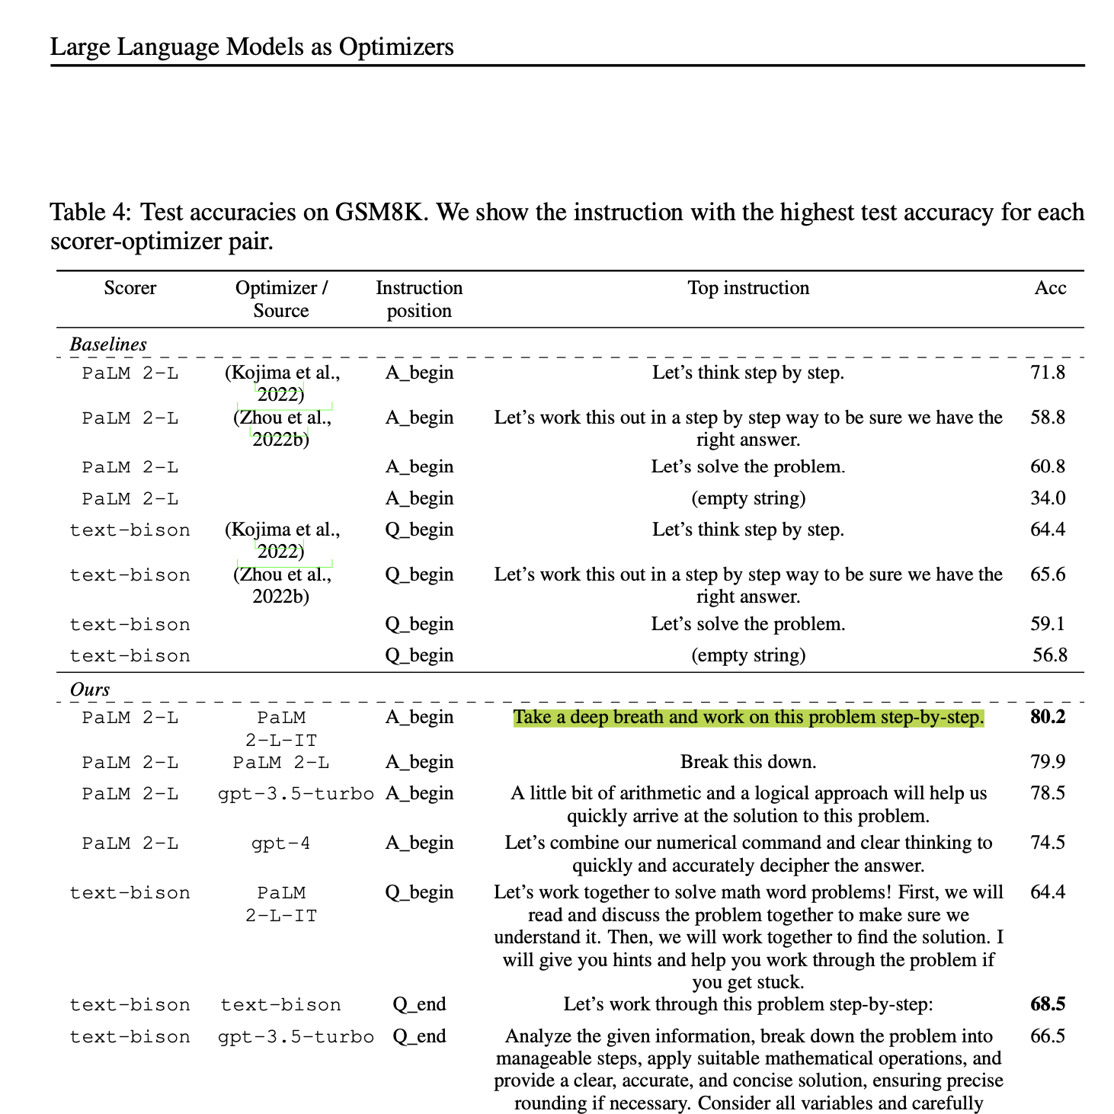
Encourage Models to Use Chain-of-Thought Reasoning
A team from Google Deepmind tested the best way to improve the quality of zero-shot prompts.
This was the winner:
“Take a deep breath and work on this problem step-by-step”
Source: Large Language Models as Optimizers – Google Deepmind
Notes:
Source: Large Language Models as Optimizers – Google Deepmind

Slide 47
Pro Tip: Surprisingly Effective Prompts
There is anecdotal evidence that each of these prompts can improve output from LLMs!
1
2
3
Do your best!
This is crucial for my career.
I will tip $20.
Notes:
Source: I will tip $20

Slide 48


Minimize Hallucinations: Allow “I don’t Know”
What is the heaviest hippo ever recorded?
Answer the following question only if you know the answer or can make a well-informed guess; otherwise tell me you don't know it.
What was the heaviest hippo ever recorded?
Source: Let Claude say "I don't know" to prevent hallucinations
Notes:
LLMs strive for accurate and honest responses, yet as we mentioned previously, they can sometimes generate "hallucinations" or inaccuracies. This phenomenon is not due to dishonesty but an overzealous attempt to provide useful information - we can reduce this quite simply by allowing them to say “I don’t know”.
PURPOSE:
This slide aims to explain why LLMs might produce inaccuracies and emphasize the importance of allowing them to acknowledge uncertainty.
TALKING POINTS:
LLMs, in their quest to be helpful, may "hallucinate," creating facts or details that aren't true, especially when they try to interpret ambiguous inputs or questions beyond their training data.
One strategy to reduce the chance of misinformation is by programming LLMs or setting user expectations that "I don't know" is an acceptable and often preferred response when certainty is unattainable.
LLMs operate very literally; without the nuanced human understanding of social contexts, they default to attempting to provide helpful information, even when that means filling in gaps with best guesses, which can lead to inaccuracies.

Slide 49
Break Complex Tasks Down
I want you to write an essay about the statement: [statement] with three topic sentences arguing for the statement, three topic sentences arguing against the statement, and a conclusion at the end.
Please follow these steps:
1. Write three topic sentences arguing for [statement].
2. Write three topic sentences arguing against [statement].
3. Write an essay by expanding each topic sentence from Steps 1 and 2, and adding a conclusion to synthesize the arguments.
Source: Anthropic

Slide 50

Tell, Don’t Ask
Can you transcribe the text in this image for me?
Transcribe the text in this image.
Notes:
Sometimes asking ChatGPT a question leads to hallucinations because “no” is technically a valid answer!
PURPOSE:
TALKING POINTS:
TEACHING TIPS:

Slide 51
Chain of Thought Prompting
10 Minutes
Strategic Planning with LLMs
Step 1: Identify a challenge or opportunity relevant to your job or department
Step 2: Craft an Initial Prompt (without using chain of thought prompting)
Step 3: Evaluate the output
Step 4: Rewrite the prompt using chain of thought prompting
Step 5: Test and make iterations as needed
Notes:
Detailed Instructions:
Step 1: Identify a Challenge or Opportunity Relevant to Your Job or Department
Take a few minutes to reflect on your current role and responsibilities.
Write down a clear and concise description of the challenge or opportunity, including its context and significance.
Step 2: Craft an Initial Prompt (Without Using Chain-of-Thought Prompting)
Create a basic prompt to ask an LLM for help addressing your problem.
Focus on describing the problem clearly and asking for a solution.
Avoid breaking the problem into steps—this will come in the next stage.
Submit the prompt to an LLM and save the output for the next step.
Step 3: Evaluate the Output
Read the AI-generated response and evaluate it based on the following criteria:
Clarity: Is the response easy to understand?
Relevance: Does it address your specific problem or opportunity?
Depth: Are the recommendations practical and detailed enough to implement?
Gaps: Are there any areas the response missed or oversimplified?
Step 4: Rewrite the Prompt Using Chain-of-Thought Prompting
Revise your original prompt to guide the LLM to think step by step.
Explicitly list the steps you want the AI to follow to solve the problem.
Test the revised prompt and compare the output to the first response.
Step 5: Test and Make Iterations as Needed
Review the AI’s step-by-step response and refine your prompt further if needed.
Add details or clarify areas where the AI’s output was unclear or incomplete.
Example Refinement: "For each step, provide actionable recommendations, potential challenges, and metrics for success."
Continue refining the prompt until the AI response is clear, actionable, and comprehensive.

Slide 52
Chain of Thought Prompting
5 Minutes
Debrief
How did the Chain-of-Thought prompting improve the AI’s response compared to the initial prompt?
What insights did you gain about crafting effective prompts?
How can this approach help you tackle similar challenges in your role?

Slide 53
LET’S TRY WORKING WITH DATA

Slide 54
Working With Multiple Data Sources
20 Minutes
Consolidating Data for Operational Insights
Step 1: Familiarize yourself with the synthetic data
Equipment_Utilization.csv
Hospital_Staffing.csv
Patient_Satisfaction.csv
Step 2: Craft a Prompt
Step 3: Generate Insights and check for accuracy
Step 4: Refine the prompt
Step 5: Generate insights and check for accuracy

Slide 55
Working With Multiple Data Sources
5 Minutes
Debrief
How did the LLM handle synthesizing insights from the three datasets (Equipment Utilization, Patient Satisfaction, and Hospital Staffing)?
What are some things that could go wrong when relying on AI-driven data consolidation?
How can AI-driven data consolidation support decision-making in your organization?

Slide 56
Notes:
10 minute break

Slide 57
AI for Leaders
Strategic Considerations &
The Art of the Possible

Slide 58
Construct a mental model for evaluating generative AI use cases
Analyze scenarios to determine where generative AI can create value
Prioritize AI opportunities based on organizational goals and constraints

Slide 59


Slide 60
All models are wrong, but some are useful.
George E. P. Box, Statistician

Slide 61
A Lens to Evaluate AI Opportunities
Desirability: How well does it need to work? What are the consequences if the model is wrong?
USER NEEDS
(desirability)
BUSINESS GOALS
(viability)
Viability: How does this align with our strategic goals? What are the risks?
GenAI
Strategy
ORGANIZATIONAL CAPABILITIES
(feasibility)
Feasibility: Is this possible with existing AI Models? Do we have the needed talent?
Notes:
PURPOSE:
Examine the framework for assessing AI opportunities through the lenses of desirability, viability, and feasibility.
TALKING POINTS:
• Desirability: Focus on the importance of AI solutions meeting user needs and providing value, while also considering the implications of inaccurate outcomes.
• Viability: Stress the alignment of AI initiatives with the organization's strategic objectives and discuss potential risks involved.
• Feasibility: Consider whether current AI technologies and the organization's talent pool can support the proposed AI projects.
• The overlap of User Needs, Business Goals, and Organizational Capabilities is where sustainable AI solutions exist - this intersection should be the goal for new AI projects.
TEACHING TIPS:
• Use real examples to illustrate each point, making the concepts concrete and relatable.
• Encourage participants to think critically about each dimension by asking them to consider how an AI project could fail if one of these aspects is neglected.
• Suggest that participants take notes on these criteria to use as a checklist when evaluating future AI opportunities.

Slide 62
Core AI Considerations in Desirability
Performance: How well does it need to work to provide value?
USER NEEDS
(desirability)
BUSINESS GOALS
(viability)
Consequences: What are the consequences when the models doesn’t work?
ORGANIZATIONAL CAPABILITIES
(feasibility)
Error Handling: In those cases, can the error be mitigated?
Notes:
PURPOSE:
Highlight the critical factors of AI performance, consequences of failure, and error mitigation in the context of desirability.
TALKING POINTS:
• Performance: Emphasize the necessity of AI systems functioning effectively to provide real value and the benchmarks for evaluating performance.
• Consequences: Discuss the potential negative outcomes if AI models fail and how these could impact users and the organization.
• Error Handling: Explore strategies for mitigating errors when they occur, including fallback procedures and human oversight mechanisms.
TEACHING TIPS:
• Use a case study where an AI model's performance directly correlated with user satisfaction to illustrate the point of 'Performance'.
• For 'Consequences', encourage participants to think about high-risk sectors like healthcare or finance, where AI errors can have significant repercussions.
• For 'Error Handling', discuss the importance of having robust systems in place for quickly identifying and rectifying AI errors to maintain trust and functionality.

Slide 63

BUILDING A DESIRABILITY “LIGHT HOUSE”
5 Minutes
An experiment in using a leading LLM to augment consulting work:
A randomized control trial involving hundreds of consultants found that those with access to a high performing LLM outperformed those without in eighteen different tasks for a fictional shoe company, across metrics like time, task completion, and output quality.
The tool empowered consultants were more efficient and produced higher-quality work in creative, analytical, and writing tasks.
Both AI and human graders rated assisted work as higher quality.
Notes:
PURPOSE:
This slide aims to illustrate the tangible impact of AI, specifically GPT-4, on enhancing the efficiency and quality of consulting work, aligning with our learning goal of understanding AI's role in the modern workplace.
TALKING POINTS:
- Emphasize the rigour of the study, with randomised control trials and diverse tasks involved.
- Highlight that both human and AI graders agreed on the superior quality, strengthening the results.
- Engage the audience with the interactive element, inviting them to guess the performance improvement percentage (shown after the mentimeter poll)
TEACHING TIPS:
- Consider asking for audience guesses before revealing any actual percentages, to engage them and gauge their expectations.
- If possible, have real-time polling (e.g. using Menti.com) to capture audience guesses on the performance boost, and reveal the actual figure afterward.
Source: Centaurs and Cyborgs on the Jagged Frontier
758 consultants from Boston Consulting Group were randomly assigned to either proactively use GPT 4.0, or were blocked from doing so.
They were given 18 different tasks representative of the type of work done at an elite management consulting firm.
Consultants using AI finished 12.2% more tasks on average, completed tasks 25.1% more quickly, and produced 40% higher quality results than those without. A huge effect.

Slide 64

Think About It: Performance Boost 🤔
Guess the performance boost (%) for the lowest performing consultants when working with a high performing LLM.
Type your response in the chat.
Notes:
PURPOSE: Encourage participants to think critically about the impact of AI tools on productivity in the consulting industry.
TALKING POINTS:
Invite speculation on how AI tools might enhance consultant efficiency and effectiveness.
Discuss the factors that contribute to performance improvement when using AI tools.
Explore expectations vs. reality in terms of productivity gains with AI assistance.
TEACHING TIPS:
You could have participants guess in bands - 10-20%, 20-30%, 30-40%, etc.
Encourage sharing of personal experiences or observations related to AI in their work.
Use this as an opportunity to discuss the importance of measuring performance and setting realistic benchmarks for AI integration.

Slide 65
A Large Enough Boost to Provide Value?
Consultants using a top performing LLM
Versus the control group
+40%
“The consultants who scored the worst [in initial tests] had the biggest jump in their overall performance, 43%.”
+25%
higher quality results.
+12%
quicker task completion
more tasks finished
Notes:
PURPOSE: This slide provides concrete numbers on how GPT-4 improves consultant performance, driving home our learning objectives of identifying key benefits and analysing AI's cross-industry impact.
TALKING POINTS:
Focus on the 43% performance jump for the initially lower-scoring consultants, illustrating GPT-4's role in elevating baseline performance.
Emphasise the 40% improvement in quality, showing that GPT-4 not only speeds up work but enhances it.
Discuss the 25% and 12% boosts in task completion and speed, suggesting that AI can optimise multiple facets of work.
TEACHING TIPS:
Use the percentages as a talking point to delve into the real-world implications. For example, "What would a 40% improvement in quality mean for your business?"
Source: Centaurs and Cyborgs on the Jagged Frontier
758 consultants from Boston Consulting Group were randomly assigned to either proactively use GPT 4.0, or were banned from doing so.
They were given 18 different tasks representative of the type of work done at an elite management consulting firm.
Consultants using AI finished 12.2% more tasks on average, completed tasks 25.1% more quickly, and produced 40% higher quality results than those without. A huge effect.

Slide 66
Human/AI Collaboration
5 Minutes
A Field Experiment on HR Recruiters
Researchers found that higher-quality AI improved task efficiency in HR recruitment
However, it led to reduced human engagement and poorer decision-making
More experienced recruiters performed significantly better when given a lower quality AI assistant.
This "falling asleep at the wheel" effect suggests that maximising AI performance alone may not yield the best outcomes in human-AI collaborations.
Notes:
PURPOSE:
This slide aims to illustrate the tangible impact of AI, specifically GPT-4, on enhancing the efficiency and quality of consulting work, aligning with our learning goal of understanding AI's role in the modern workplace.
TALKING POINTS:
- Emphasize the rigour of the study, with randomised control trials and diverse tasks involved.
- Highlight that both human and AI graders agreed on the superior quality, strengthening the results.
- Engage the audience with the interactive element, inviting them to guess the performance improvement percentage (shown after the mentimeter poll)
TEACHING TIPS:
- Consider asking for audience guesses before revealing any actual percentages, to engage them and gauge their expectations.
- If possible, have real-time polling (e.g. using Menti.com) to capture audience guesses on the performance boost, and reveal the actual figure afterward.
Source: Centaurs and Cyborgs on the Jagged Frontier
758 consultants from Boston Consulting Group were randomly assigned to either proactively use GPT 4.0, or were blocked from doing so.
They were given 18 different tasks representative of the type of work done at an elite management consulting firm.
Consultants using AI finished 12.2% more tasks on average, completed tasks 25.1% more quickly, and produced 40% higher quality results than those without. A huge effect.

Slide 67
Leaders must consider the
falling asleep at the wheel effect
when deploying AI tools across teams
Notes:
Source: Falling Asleep at the Wheel: Human/AI Collaboration in a Field Experiment on HR Recruiters
In another experiment, this time in the field of HR, researchers found that while higher-quality AI improved task efficiency in HR recruitment, it led to reduced human engagement and poorer decision-making, particularly among experienced recruiters. They became much more careless, overly reliant on the tool, and less trusting in their own judgment.
Interestingly, the more experienced recruiters performed significantly better when given a lower quality AI assistant.
This "falling asleep at the wheel" effect suggests that maximising AI performance alone may not yield the best outcomes in human-AI collaborations.
PURPOSE: This slide serves as a cautionary note, urging attention and oversight even when AI is involved, advancing our objectives of understanding AI’s nuanced impact on businesses and human roles.
TALKING POINTS:
Highlight the tension between increasing AI accuracy and diminishing human effort in decision-making.
Point out that experienced recruiters were more susceptible to "falling asleep at the wheel" with high-quality AI, illustrating that the issue isn't just for newcomers.
Discuss how the study underscores the complexity of designing human-AI collaborations that enhance rather than dilute human skills and engagement.
TEACHING TIPS:
Use this slide to segue into real-world applications, asking, “How could your company be at risk of 'falling asleep at the wheel' with AI?”

Slide 68




High vs. Low Consequences
Vs.
Notes:
PURPOSE: Demonstrate the difference between high-impact AI systems (like self-driving cars) and low-impact AI systems (like virtual assistants) in terms of potential consequences.
TALKING POINTS • Tesla’s Autopilot system has life-or-death implications—failure can cause accidents, injuries, or property damage. • Alexa handles lower-stakes requests—errors typically lead to minor inconveniences like misheard commands or incorrect orders. • This contrast highlights why AI design, testing, and oversight can vary widely based on the potential harm to users.
TEACHING TIPS • Encourage learners to brainstorm real-world examples of both high and low consequence AI tools, and discuss how product teams handle risk differently in each scenario.

Slide 69
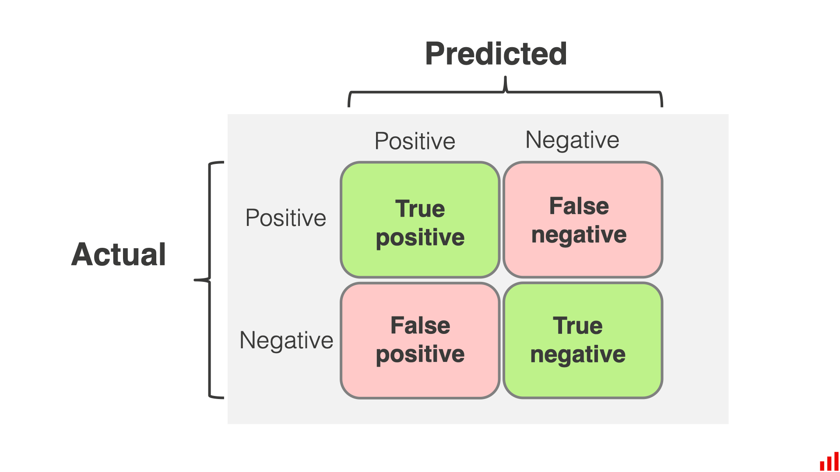
End User Consequences in Healthcare
10 Minutes
What are examples of high and low consequences in healthcare?
High vs low?
optimize appointment scheduling,
manage medication renewals,
streamline telehealth consultations,
generate personalized treatment plans based on patient data
assist with clinical documentation by summarizing key information from medical records
Other examples?
How does this relate to the “Confusion Matrix”
Notes:
PURPOSE: Prompt a conversation about which healthcare applications of AI carry higher or lower patient and clinical risk, and connect these examples to the importance of model accuracy (as illustrated by the confusion matrix).
TALKING POINTS
High vs. Low Consequence Tasks
High: Generating personalized treatment plans, suggesting medication adjustments, or giving diagnostic insights—these directly impact patient health and carry greater risk if the AI is incorrect.
Low: Administrative tasks like scheduling appointments or summarizing medical records for documentation—errors might be inconvenient but typically not life-threatening.
Examples & Considerations
Appointment scheduling errors can cause workflow issues, but they’re usually fixable.
An incorrect medication renewal or a flawed treatment plan can lead to severe patient harm.
Confusion Matrix Relevance
False positives and false negatives have different consequences in healthcare.
In a clinical setting, a false negative could mean a missed diagnosis; a false positive could mean unnecessary treatment—both have real implications for patient well-being.
TEACHING TIPS
Ask participants to categorize different healthcare AI use cases as “high” or “low” consequence and justify their decisions.
Use a real or hypothetical scenario: “What happens if the AI incorrectly flags a patient’s medication dosage?” vs. “What if the AI double-books appointments?”
Emphasize the role of human oversight, especially for tasks that are high consequence. A high-stakes setting requires rigorous validation and error-checking for AI outputs.

Slide 70
Core AI Considerations in Viability
Business Model: Is the cost structure appropriate for the business value?
USER NEEDS
(desirability)
BUSINESS GOALS
(viability)
Strategic Positioning: Does the AI ladder up to a broader company goal?
Risk & Compliance: Do we have a suitable compliance engine to monitor AI risk?
ORGANIZATIONAL CAPABILITIES
(feasibility)
Notes:
PURPOSE:
Analyze the viability of AI initiatives through the lens of business model, strategic positioning, and risk and compliance.
TALKING POINTS:
• Business Model: Stress the importance of aligning the cost structure with the anticipated business value derived from AI technologies.
• Strategic Positioning: Discuss how AI initiatives should support and enhance the broader strategic goals of the company.
• Risk & Compliance: Consider the mechanisms required for monitoring AI risks and ensuring compliance with relevant laws and ethical standards.
TEACHING TIPS:
• Highlight the need for a balance between investment in AI and the expected ROI, cautioning against solutions that do not scale financially.
• Use examples of companies that have successfully integrated AI to advance their strategic objectives, as well as cautionary tales of those who haven't.
• Emphasize the evolving nature of AI governance, and the need for dynamic systems to manage risk and ensure compliance effectively.

Slide 71
Different Strategic Approaches to Adoption
Transformative
Incremental
Rebuild entire practice domains with GenAI at their core.
Identify individual use cases for internal and external applications.
VS.

Slide 72
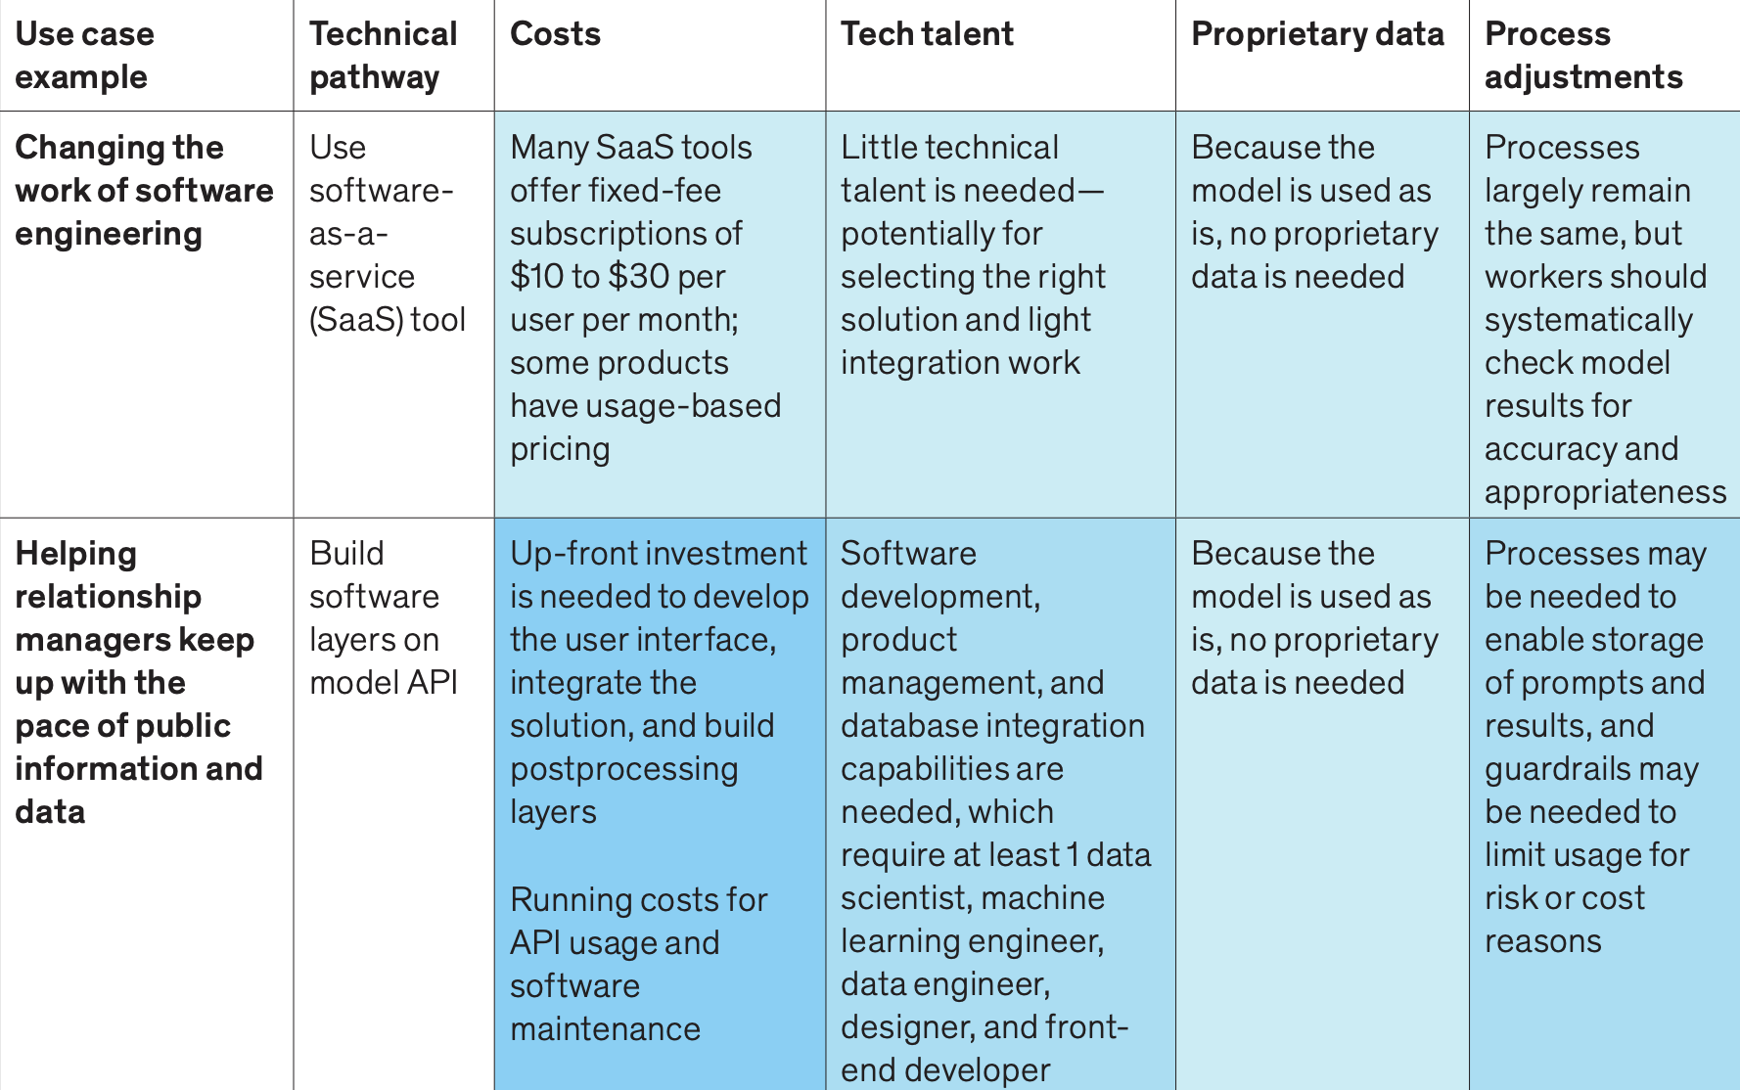
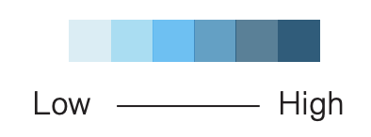
Incremental Changes - Low Effort Use Cases
(Effort)
Source: McKinsey, 2023
Notes:
https://www.mckinsey.com/il/~/media/mckinsey/business%20functions/mckinsey%20digital/our%20insights/what%20every%20ceo%20should%20know%20about%20generative%20ai/what-every-ceo-should-know-about-generative-ai.pdf
PURPOSE: Provide examples of AI integrations that require lower investment, simpler technical pathways, and minimal process adjustments.
TALKING POINTS
Many off-the-shelf SaaS AI solutions offer fixed-fee or usage-based pricing, reducing cost barriers.
Little in-house tech talent is needed beyond choosing the right product and performing light integration.
Because the model is used as-is (no proprietary data input), processes remain largely the same, but teams should verify model output for accuracy and suitability.
TEACHING TIPS
Ask participants to brainstorm existing SaaS tools they already use and discuss how these might incorporate basic AI features.
Emphasize the importance of continuously monitoring AI output, even at lower levels of investment and risk.

Slide 73
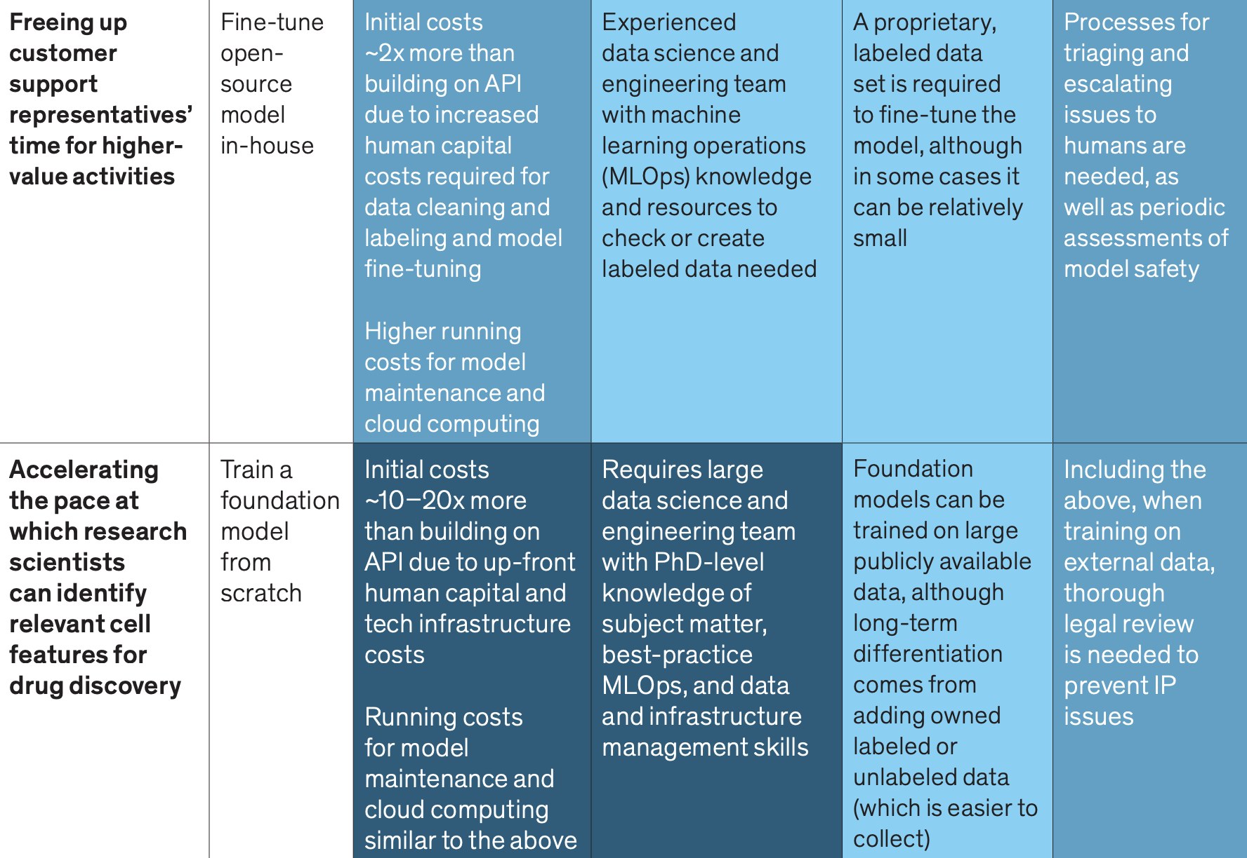
Transformational Changes - High Effort Use Cases
(Effort)
Source: McKinsey, 2023
Notes:
https://www.mckinsey.com/il/~/media/mckinsey/business%20functions/mckinsey%20digital/our%20insights/what%20every%20ceo%20should%20know%20about%20generative%20ai/what-every-ceo-should-know-about-generative-ai.pdf
PURPOSE: Illustrate AI initiatives that demand extensive resources, specialized expertise, and significant changes to an organization’s infrastructure and processes.
TALKING POINTS
Fine-tuning or building AI models in-house incurs higher upfront costs (for data cleaning, labeling, and model creation).
Advanced data science teams, including MLOps experts and PhD-level researchers, are often required.
Proprietary labeled data may be necessary to train or fine-tune a model, requiring robust data management strategies.
Ongoing oversight and human intervention are critical for risk management, especially in complex or safety-sensitive use cases.
TEACHING TIPS
Encourage learners to compare these high-investment use cases with smaller AI integrations to understand trade-offs in cost, talent, and strategic impact.
Prompt discussion on when it might be necessary to build a custom model rather than relying on off-the-shelf or API-based solutions.
Remind participants that long-term differentiation often comes from proprietary data and custom model development.

Slide 74
HALLUCINATIONS ARE A FEATURE
NOT A BUG

Slide 75
Medical Summaries with LLMs
5 Minutes
Almost HALF of AI Generated Medical Summaries Had Hallucinations
The pilot study prompted GPT-4o and Llama-3 to create 500-word summaries of 50 detailed medical notes.
Research found that GPT-4o had 21 summaries with incorrect information and 50 summaries with generalised information, while Llama-3 had 19 and 47, respectively.
The researchers noted that Llama-3 tended to report details “as is” in its summaries whilst GPT-40 made “bold, two-step reasoning statements” that can lead to hallucinations.
Notes:
https://www.clinicaltrialsarena.com/news/hallucinations-in-ai-generated-medical-summaries-remain-a-grave-concern/?cf-view
PURPOSE: Show how large language models (LLMs) can generate inaccurate or “hallucinated” medical summaries, highlighting real-world pitfalls in sensitive fields.
TALKING POINTS
A pilot study asked GPT-4o and Llama-3 to create 500-word summaries of 50 detailed medical notes.
GPT-4o produced 21 incorrect summaries and 50 “generalized” ones; Llama-3 had 19 and 47, respectively.
Researchers observed that Llama-3 stuck to the details “as is,” while GPT-4o used more “two-step reasoning,” occasionally creating false or misleading content.
TEACHING TIPS
Emphasize to learners that while LLMs can appear authoritative, careful review of AI-generated medical information is essential.
Highlight the impact of minor inaccuracies in high-stakes fields like healthcare and discuss strategies (e.g., human-in-the-loop) to mitigate these risks.

Slide 76
Business Risk Consideration - Privacy
Survey Insights:
Dark Leak Examples
Data Management Priorities
77% of companies report successful AI pilots (Alteryx)
80% cite data privacy and security as top challenges
45% faced unintended data exposure (AvePoint)
Microsoft AI leaked 38 terabytes of data
Shine a light on unprotected "dark data"
Improve data permissions, labeling, and classification
Notes:
Source: https://www.cnbc.com/2024/05/16/the-no-1-risk-companies-see-in-gen-ai-usage-isnt-hallucinations.html
PURPOSE: Explain that the biggest risk that organizations worry about are data leaks and privacy
TALKING POINTS:
Besides hallucinations, code errors, copyright infringement and perpetuated bias, what organizations worry about most is data leaks
80% of organizations site data privacy and security concerns that present a challenge for scaling AI
45% encountered unintended data exposure when implementing AI solutions
Most of the leaked information is “unprotected“ dark data
How to improve data protection and permissions:
Understand your company data and make sure that your users do to

Slide 77
Core AI Considerations in Feasibility
Talent: Do we have the skills (ML Engineers, Data Scientists, AI trained product devs) to execute?
USER NEEDS
(desirability)
BUSINESS GOALS
(viability)
Infrastructure: Does our existing infrastructure meet the AI requirements, if not what is the LOE to get there?
AI Performance requirements: With the existing capabilities and limitations of AI, is it even possible to reach the performance requirements?
ORGANIZATIONAL CAPABILITIES
(feasibility)
Notes:
PURPOSE:
Discuss the feasibility of AI projects in terms of talent, infrastructure, and AI performance requirements.
TALKING POINTS:
• Talent: Address the importance of having the right mix of skills within the team, including machine learning engineers, data scientists, and AI-trained product developers.
• Infrastructure: Examine whether our current technological infrastructure supports AI initiatives and the level of effort (LOE) required to bridge any gaps.
• AI Performance Requirements: Deliberate on the realistic expectations of AI performance given our existing capabilities and the technological limitations we may face.
TEACHING TIPS:
• Encourage a proactive approach to talent development, such as investing in training programs and considering partnerships with educational institutions.
• Discuss the scalability of infrastructure and the importance of planning for future needs as well as immediate requirements.
• Prompt participants to consider case studies where AI performance requirements were not met and the lessons learned from those experiences.

Slide 78
Incremental Changes - Low Effort Use Cases
(Effort)
Source: McKinsey, 2023
Notes:
Source: https://www.mckinsey.com/il/~/media/mckinsey/business%20functions/mckinsey%20digital/our%20insights/what%20every%20ceo%20should%20know%20about%20generative%20ai/what-every-ceo-should-know-about-generative-ai.pdf
PURPOSE: Show how organizations can adopt AI with minimal technical and financial investment, focusing on SaaS tools and simple API integrations.
TALKING POINTS
Cost Model: Many SaaS solutions use fixed-fee or usage-based pricing (e.g., $10–$30 per user/month), reducing up-front risk.
Talent Needs: Often limited to selecting the right vendor and doing light integration—no major in-house data science team required.
Proprietary Data: Not strictly needed if the model is used as-is. However, teams must still monitor outputs for accuracy.
Process Adjustments: Mostly minor; workers can keep existing workflows but should systematically review AI-generated results.
TEACHING TIPS
Encourage learners to brainstorm potential low-effort AI solutions in their own work areas.
Emphasize the importance of quality checks and user training—even with pre-built solutions—so the AI doesn’t produce unchecked errors.

Slide 79
Transformational Changes - High Effort Use Cases
(Effort)
Source: McKinsey, 2023
Notes:
Source: https://www.mckinsey.com/il/~/media/mckinsey/business%20functions/mckinsey%20digital/our%20insights/what%20every%20ceo%20should%20know%20about%20generative%20ai/what-every-ceo-should-know-about-generative-ai.pdf
PURPOSE: Illustrate large-scale AI initiatives that require extensive investment, specialized expertise, and possibly major operational adjustments.
TALKING POINTS
Cost & Complexity: Fine-tuning or building AI models in-house may double or even multiply costs by 10–20x compared to plugging into an existing API.
Talent Requirements: Advanced data science/engineering teams (including MLOps experts) are needed, especially for sophisticated model training or fine-tuning.
Proprietary Data: Acquiring or creating labeled data to train/fine-tune these models can be resource-heavy—but can yield unique, strategic advantages.
Process Adjustments: Rigorous oversight is essential—plans for triaging AI errors, ensuring model safety, and conducting legal reviews (especially if training on external data).
TEACHING TIPS
Highlight scenarios where building a model from scratch is worth it—e.g., highly specialized tasks or proprietary workflows that no off-the-shelf tool can address.
Prompt discussion about the trade-offs between shorter-term, lower-cost solutions vs. long-term, potentially game-changing AI investments.
Remind learners that these high-effort use cases often bring greater business differentiation but also come with higher risk.

Slide 80
Bringing it all together:
Be Prepared To share!
10 Minutes
In your groups, discuss a possible use case/implementation for a Large Language Model.
Is this an incremental change or transformational change?
What DESIRABILITY, VIABILITY, FEASIBILITY considerations should we be evaluating?

Slide 81
AI for Leaders
The Future of AI

Slide 82
Investigate current predictions and trends shaping the future of AI
Evaluate potential applications for large language models within your organization

Slide 83
AI WILL BE AS UBIQUITOUS
AS THE INTERNET

Slide 84

Agentic AI: Building AI Agents in Copilot Studio
Agentic AI is something you may start hearing about more and more.
Luckily, AI agents are also becoming easier and easier for users to create!
Notes:
PURPOSE: Introduce the concept of agentic AI and emphasize how tools like Copilot Studio make creating AI agents more accessible to a broader audience.
TALKING POINTS • What is Agentic AI? Explain that agentic AI refers to AI systems capable of autonomous action or decision-making with minimal human oversight. • Rising Popularity: Point out that we’re seeing more coverage of AI agents in both industry and media, illustrating the trend toward “smarter,” more proactive AI solutions. • Ease of Creation: Stress that new platforms—such as Copilot Studio—are lowering the barriers to building and deploying AI agents, even for non-experts.
TEACHING TIPS • Invite learners to brainstorm everyday tasks or workflows that might benefit from an AI agent’s autonomy. • Provide examples or a short demo in Copilot Studio, if possible, to show how quickly an AI agent can be designed and deployed. • Encourage discussion about potential risks and safeguards when creating agentic AI (e.g., setting clear boundaries or supervision).

Slide 85


Slide 86
What You Should do Next
1
Build your Lighthouse
5
Organize a Cross-Functional Committee
2
Balance Risk & Value Creation
6
Build Partnerships in the Ecosystem
3
Enable a Fully Loaded Tech Stack
7
Refocus the Talent and Skills Gap
4
Domain Reimagining
vs. Single Use Cases
8
Deep Partnership with Assurance, Legal, & Compliance

Slide 87

Survey

